Slide 1
Unit -1
Installation & configuration of Servers
Introduction

Slide 2
Server
A server is a type of computer or device on a network that manages network resources. Servers are often dedicated, meaning that they perform no other tasks besides their server tasks. On multiprocessing operating systems, however, a single computer can execute several programs at once. A server in this case could refer to the program that is managing resources rather than the entire computer.
Different Types of Servers
Different types servers do different jobs, from serving email and video to protecting internal networks and hosting websites. There are many different types of servers, for example:
File server: a computer and storage device dedicated to storing files. Any user on the network can store files on the server.
Print server: a computer that manages one or more printers, and a network server is a computer that manages network traffic.
Database server: a computer system that processes database queries.

Slide 3
Linux Origin
Linux began in 1991 as a personal project by Finnish student Linus Torvalds: to create a new free operating system kernel.
After AT&T had dropped out of the Multics project, the Unix operating system was conceived and implemented by Ken Thompson and Dennis Ritchie (both of AT&T Bell Laboratories) in 1969 and first released in 1970.
Later they rewrote it in a new programming language, C, to make it portable. The availability and portability of Unix caused it to be widely adopted, copied and modified by academic institutions and businesses.

Slide 4
Components of Linux System
Kernel − Kernel is the core part of Linux. It is responsible for all major activities of this operating system. It consists of various modules and it interacts directly with the underlying hardware. Kernel provides the required abstraction to hide low level hardware details to system or application programs.
System Library − System libraries are special functions or programs using which application programs or system utilities accesses Kernel's features. These libraries implement most of the functionalities of the operating system and do not requires kernel module's code access rights.
System Utility − System Utility programs are responsible to do specialized, individual level tasks.

Slide 5
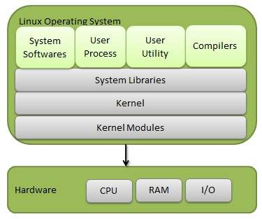

Slide 6
Duties of the system administration
Installing and configuring software, hardware and networks
Monitoring system performance and troubleshooting issues
Ensuring security
Install and configure software and hardware
Manage network servers and technology tools
Set up accounts and workstations
Monitor performance and maintain systems according to requirements
Troubleshoot issues and outages
Ensure security through access controls, backups and firewalls
Upgrade systems with new releases and models
Develop expertise to train staff on new technologies
Build an internal wiki with technical documentation, manuals and IT policies

Slide 7
Planning the network
It is important to plan your environment's networking topology and subnets so that you can properly map roles and services to correctly communicate with each other.
Understanding topologies
Determining system requirements
Planning and Implementing Security :
Formulating a security policy-
(i)AN EFFECTIVE PASSWORD POLICY
(ii) GENERAL SECURITY RULES
(iii) SECURITY UPDATES
(iv) AN APPROPRIATE FIREWALL SYSTEM
Planning for Recovery from Disasters

Slide 8
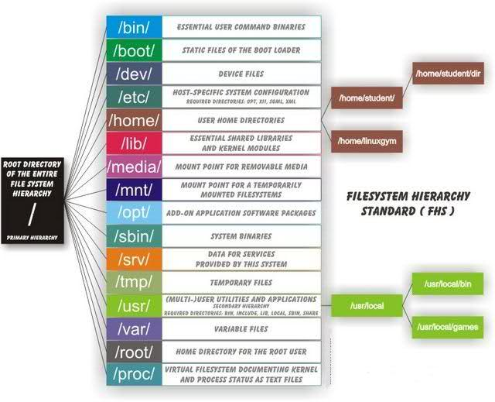
File System hierarchy

Slide 9
/bin : All the executable binary programs (file) required during booting, repairing, files required to run into single-user-mode, and other important, basic commands viz., cat, du, df, tar, rpm, wc, etc.
/boot : Holds important files during boot-up process, including Linux Kernel.
/dev : Contains device files for all the hardware devices on the machine e.g., cdrom, cpu, etc
/etc : Contains Application’s configuration files, startup, shutdown, start, stop script for every individual program.
/home : Home directory of the users. Every time a new user is created, a directory in the name of user is created within home directory which contains other directories like Desktop, Downloads, Documents, etc.
/lib : The Lib directory contains kernel modules and shared library images required to boot the system and run commands in root file system.
/media : Temporary mount directory is created for removable devices viz., media/cdrom.
/mnt : Temporary mount directory for mounting file system.

Slide 10
/opt : Optional is abbreviated as opt. Contains third party application software. Viz., Java, etc.
/proc : A virtual and pseudo file-system which contains information about running process with a particular Process-id.
/root : This is the home directory of root user and should never be confused with ‘/‘
/run : This directory is the only clean solution for early-runtime-dir problem.
/sbin : Contains binary executable programs, required by System Administrator, for Maintenance. Viz., iptables, fdisk, ifconfig, swapon, reboot, etc.
/srv : Service is abbreviated as ‘srv‘. This directory contains server specific and service related files.
/sys : Modern Linux distributions include a /sys directory as a virtual filesystem, which stores and allows modification of the devices connected to the system.
/tmp :System’s Temporary Directory, Accessible by users and root. Stores temporary files for user and system, till next boot.
/usr : Contains executable binaries, documentation, source code, libraries for second level program.
/var : Stands for variable. The contents of this file is expected to grow. This directory contains log, lock, spool, mail and temp files.

Slide 11
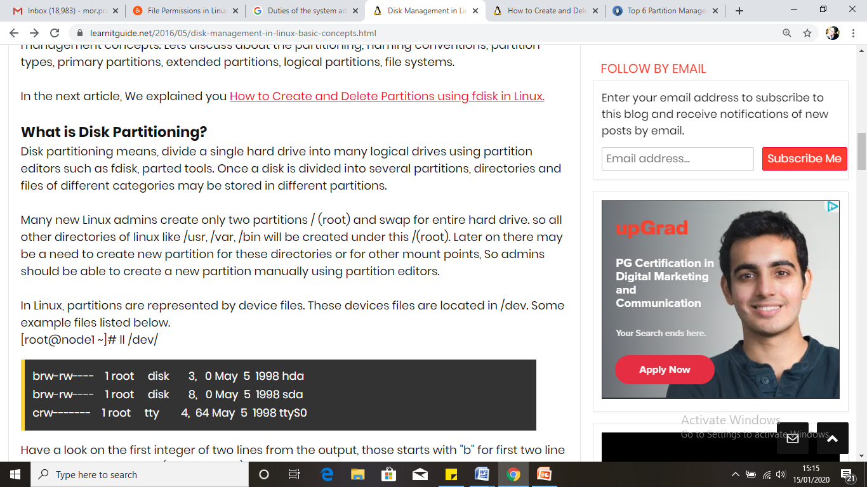
Disk Management

Slide 12
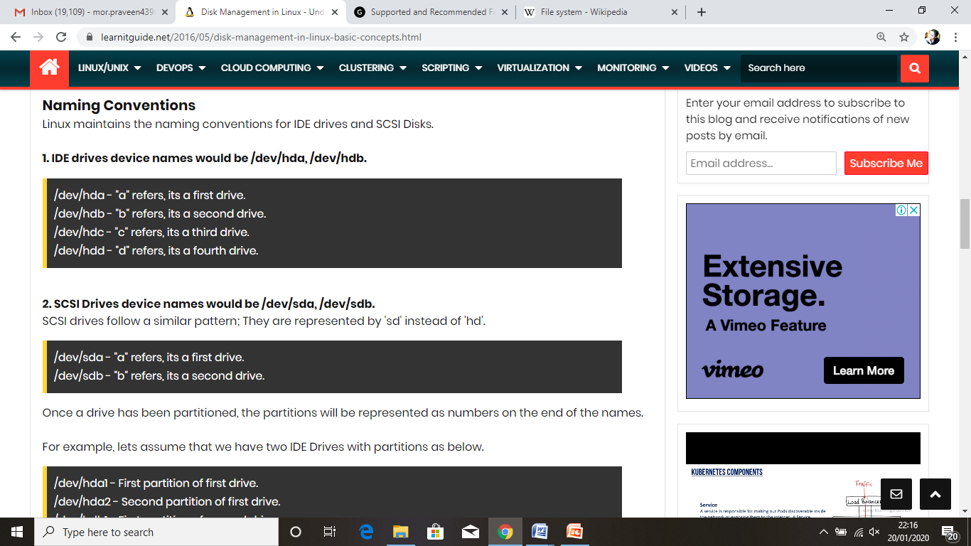

Slide 13
What is a Partition?
Partitioning is a means to divide a single hard drive into many logical drives.
A partition is a contiguous set of blocks on a drive that are treated as an independent disk.
A partition table is an index that relates sections of the hard drive to partitions.

Slide 14
Why have multiple partitions?
Linux Installation
Reduce the risk of system failure in case a partition becomes full. Runaway processes or maniacal users can consume so much disk space that the operating system no longer has room on the hard drive for its bookkeeping operations. This will lead to disaster. By segregating space, you ensure that things other than the operating system die when allocated disk space is exhausted.
Encapsulate your data. Since file system corruption is local to a partition, you stand to lose only some of your data if an accident occurs.

Slide 15
Partition Fields
Linux Installation
Device: This field displays the partition's device name.
Start: This field shows the sector on your hard drive where the partition begins.
End: This field shows the sector on your hard drive where the partition ends.
Size: This field shows the partition's size (in MB).
Type: This field shows the partition's type (for example, ext2, ext3, or vfat).
Mount Point: A mount point is the location within the directory hierarchy at which a volume exists; the volume is "mounted" at this location. This field indicates where the partition will be mounted.

Slide 16
Filesystem Types
Linux Installation
ext2 — An ext2 filesystem supports standard Unix file types (regular files, directories, symbolic links, etc). It provides the ability to assign long file names, up to 255 characters. Versions prior to Red Hat Linux 7.2 used ext2 filesystems by default.
ext3 — The ext3 filesystem is based on the ext2 filesystem and has one main advantage — journaling. Using a journaling filesystem reduces time spent recovering a filesystem after a crash as there is no need to fsck the filesystem.
swap — Swap partitions are used to support virtual memory. In other words, data is written to a swap partition when there is not enough RAM to store the data your system is processing.
vfat — The VFAT filesystem is a Linux filesystem that is compatible with Windows 95/NT long filenames on the FAT filesystem.

Slide 17
Disk Partition
Linux Installation
IDE Disk Partitions
/dev/hda (Primary Master Disk)
/dev/hda1 (First Primary Partition)
/dev/hda2 (Second Primary Partition)
/dev/hdb (Primary Slave Partition)
/dev/hdb1
/dev/hdc (Secondary Master/Slave Partition)
/dev/hdc1
SCSI Disk Partitions
/dev/sda1, /dev/sda2
/dev/sdb1, /dev/sdb2
/dev/sdc1, /dev/sdc2

Slide 18
Software RAID and LVM
Linux Installation
Software RAID (Redundant Array of Inexpensive Disk)
RAID, or a redundant array of independent disks, is a storage solution intended to improve some combination of fault tolerance, storage management, and performance. RAID works as a form of storage virtualization that combines multiple physical disks into one logical volume.
RAID 0 (Striping)
RAID 1 (Mirroring)
RAID 5 (Striping with Parity)
LVM (Logical Volume Manager)
Logical Volume Manager (LVM) is a device mapper target that provides logical volume management for the Linux kernel. Most modern Linux distributions are LVM-aware to the point of being able to have their root file systems on a logical volume.

Slide 19
Working With Linux—Supported File Systems
Linux is a very flexible operating system that has a long history of interoperability with other systems on a number of different hardware platforms. A consequence of this friendliness to other operating systems is that Linux can read and write to several different file systems that originated with other operating systems much different from Linux.
Virtual File Systems (VFS)
One reason that Linux supports so many file systems is because of the design of its Virtual File Systems (VFS) layer.
The VFS layer is a data abstraction layer between the kernel and the programs in userspace that issues file system commands.
Programs that run inside the kernel are in kernelspace. Programs that don’t run inside the kernel are in userspace .The VFS layer avoids duplication of common code between all file systems.

Slide 20
ext2, ext3, ext4
– The ext2, ext3 and ext4 file systems are closely related. – ext2 can be converted to ext3. – ext3 can be mounted as an ext2 file system. – ext3 is a journaled file system. – ext3 has several performance enhancements to ext2. – ext3 can be mounted as ext4. – ext4 has all features provided by ext3 and provides features for larger filesystems, performance, increased limits, reliability.
REISERFS
The Reiser file system is a journaling file system designed for fast server perfor- mance. It is more space efficient than most other file systems, because it does not take up a minimum of one block per file. If you write a bunch of really small files to disk, reiserfs squeezes them all into one block instead of writing one small file to one block like other file systems do. Reiserfs also does not have fixed space alloca- tion for inodes, which saves about 6 percent of your disk space.
SYSTEMV
Linux currently provides read support for SystemV partitions, and write support is experimental. The SystemV file system driver currently supports AFS/EAFS/EFS, Coherent FS, SystemV/386 FS, Version 7 FS, and Xenix file systems.

Slide 21
UFS
ufs (Unix file system )is used in Solaris and early BSD operating systems. Linux provides read support, and write support is experimental.
FAT
FAT is one of a few different file systems used with Windows over the years. Almost every computer user has used FAT at one time or another.
NTFS
NTFS(New Technology File System) is the next generation of HPFS(High Performance File System . It comes with all business versions of Microsoft operating systems beginning with Windows NT. Unlike FAT, it is a b-tree file system, meaning it has a performance and reliability advantage over FAT.
HPFS
The High Performance File System first came with OS/2 Version 1 created by Microsoft. It’s the standard OS/2 file system. Since OS/2 usage has dropped off significantly, HPFS has become a relatively uncommon file system.
HFS
The Hierarchical File System is used with older versions of Mac OS. Macintosh- formatted files have two parts to them: a data fork and a resource fork. The resource fork contains Macintosh operating system-specific information such as dialog boxes and menu items. The data fork contains the meat of the file data. The data fork is readable by Unix.

Slide 22
LINUX Commands
Linux Commands
A command is a program which interacts with the kernel to provide the environment and perform the functions called for by the user.
A command can be: a built-in shell command; an executable shell file, known as a shell script; or a source compiled, object code file.
The shell is a command line interpreter. The user interacts with the kernel through the shell. You can write ASCII (text) scripts to be acted upon by a shell.

Slide 23
LINUX Shell
Linux Commands
The shell sits between you and the operating system, acting as a command interpreter.
It reads your terminal input and translates the commands into actions taken by the system. The shell is analogous to command.com in DOS.
When you log into the system you are given a default shell.
When the shell starts up it reads its startup files and may set environment variables, command search paths, and command aliases, and executes any commands specified in these files.

Slide 24
LINUX Shell
Linux Commands
The original shell was the Bourne shell, sh.
Every Unix platform will either have the Bourne shell, or a Bourne compatible shell available.
The default prompt for the Bourne shell is $ (or #, for the root user).
Another popular shell is C Shell. The default prompt for the C shell is %.

Slide 25
LINUX COMMANDS
Linux Commands
File Management and Viewing
Filesystem Mangement
Help, Job and Process Management
Network Management
System Management
User Management
Printing and Programming
Document Preparation
Miscellaneous

Slide 26
Command Structure
Linux Commands
Command <Options> <Arguments>
Multiple commands separated by ; can be executed one after the other

Slide 27
Help Facilities for Commands
Linux Commands
To understand the working of the command and possible options use (man command)
Using the GNU Info System (info, info command)
Listing a Description of a Program (whatis command)
Many tools have a long−style option, `−−help', that outputs usage information about the tool, including the options and arguments the tool takes. Ex: whoami --help

Slide 28
Pipes
Linux Commands
An important early development in Unix was the invention of "pipes," a way to pass the output of one tool to the input of another.
eg. $ who | wc −l
By combining these two tools, giving the wc command the output of who, you can build a new command to list the number of users currently on the system

Slide 29
Linux File Management and Viewing
Linux Commands
File and Directory management
cd Change the current directory. With no arguments "cd" changes to the users home directory. (cd <directory path>)
chmod Change the file permissions.
Ex: chmod 751 myfile : change the file permissions to rwx for owner, rx for group and x for others
Ex: chmod go=+r myfile : Add read permission for the group and others (character meanings u-user, g-group, o-other, + add permission,-remove,r-read,w-write,x-exe) Ex: chmod +s myfile - Setuid bit on the file which allows the program to run with user or group privileges of the file.

Slide 30
Linux File Management and Viewing
Linux Commands
chown Change owner.
Ex: chown <owner1> <filename> : Change ownership of a file to owner1.
chgrp Change group.
Ex: chgrp <group1> <filename> : Change group of a file to group1.
cp Copy a file from one location to another.
Ex: cp file1 file2 : Copy file1 to file2
Ex: cp –R dir1 dir2 : Copy dir1 to dir2

Slide 31
Linux File Management and Viewing
Linux Commands
ls List contents of a directory.
Ex: ls, ls –l , ls –al
mkdir Make a directory.
Ex: mkdir <directory name> : Makes a directory
Ex mkdir –p /www/chache/var/log will create all the directories starting from www.
mv Move or rename a file or directory.
Ex: mv <source> <destination>

Slide 32
Linux File Management and Viewing
Linux Commands
find Find files (find <start directory> -name <file name> -print)
Ex: find /home –name readme -print
(Search for readme starting at home and output full path.) “/home" = Search starting at the home directory and proceed through all its subdirectories
"-name readme" = Search for a file named readme
"-print" = Output the full path to that file
locate File locating program that uses the slocate database.
Ex: locate –u to create the database,
locate <file/directory> to find file/directory

Slide 33
Linux File Management and Viewing
Linux Commands
pwd Print or list the present working directory with full path.
rm Delete files (Remove files). (rm –rf <directory/file>)
rmdir Remove a directory. The directory must be empty. (rmdir <directory>)
touch Change file timestamps to the current time. Make the file if it doesn't exist. (touch <filename>)
whereis Locate the binary and man page files for a command. (whereis <program/command>)
which Show full path of commands where given commands reside. (which <command>)

Slide 34
Linux File Management and Viewing
Linux Commands
cat View a file
Ex: cat filename
cmp Compare two files.
cut Remove sections from each line of files.
diff Show the differences between files.
Ex: diff file1 file2 : Find differences between file1 & file2.
echo Display a line of text.

Slide 35
Linux File Management and Viewing
Linux Commands
grep List all files with the specified expression. (grep pattern <filename/directorypath>) Ex: ls –l |grep sidbi : List all lines with a sidbi in them.
Ex: grep " R " : Search for R with a space on each side
sleep Delay for a specified amount of time.
sort Sort a file alphabetically.
uniq Remove duplicate lines from a sorted file.
wc Count lines, words, characters in a file. (wc –c/w/l <filename>).

Slide 36
Red Hat System Configuration File
The Red Hat system configuration files can fall within a few different functions.
Some specify system duties, such as logging and automatically running programs with cron.
Some set default configurations for important programs such as send- mail and Bash.
And many other system configuration files are responsible for arranging the appearance of the system, such as setting the colors that show up when a directory listing is shown, and what banners pop up when someone logs in.

Slide 37
Examining the Network Configuration Files
Files to change when setting up a system or moving the system
Whenever you set up a system to work on a new network, either because you’ve just installed Red Hat or you’re moving the machine from one location to another, a set of files need to be modified to get it working on the new network.
Set up the IP addresses of your network interfaces. Make changes to:
/etc/sysconfig/network-scripts/ifcfg-eth0
/etc/sysconfig/network-scripts/ifcfg-eth1
Set up the hostname of your machine. Make changes to:
/etc/sysconfig/network
/etc/hosts
Set up a default gateway. Make changes to:
/etc/default-route
Set up the DNS servers to reference. Make changes to:
/etc/resolv.conf
Make a local file of hostname to IP address mappings. Make changes to:
/etc/hosts
Set up the device order from which hostnames are looked up. Make changes to:
/etc/nsswitch.conf

Slide 38
System configuration files in the /etc/sysconfig directory
These files set the parameters used by many of the system hardware devices, as well as the operation of some system services.
APMD
apmd contains configuration information for the advanced power management dae- mon to follow. This is most useful for laptops rather than servers, since it contains lots of settings to suspend your linux machine, and restore it again.
CLOCK
This file contains information on which time zone the machine is set to, and whether or not it is using Greenwich Mean Time for its system clock time.
AMD
amd is the file system automounter daemon. It automatically mounts an unmounted file system whenever a file or directory within that file system is accessed. File sys- tems are automatically unmounted again after a period of disuse.
UPS
This file contains information on what UPS is attached to your system. You can specify your UPS model, to make it easier for the Linux system to communicate with your UPS when the UPS needs to shut down the system.

